Slide 1
A300 Series Solar Panel Array
A Comprehensive Guide
Notes:
This presentation was automatically generated by PowerPoint Copilot based on content found in this document: https://microsoft.sharepoint.com/teams/ContosoGreenEnergy/_layouts/15/Doc.aspx?sourcedoc=%7B0DB5FDFC-3C83-40EF-B674-2899F2E1B117%7D&file=Contoso%20A300%20Solar%20Panel%20Array.docx&action=default&mobileredirect=true&DefaultItemOpen=1 AI-generated content may be incorrect.

Slide 2
Agenda
Introduction
Solar Panel Specifications
Installation Guidelines
Maintenance Tips
Environmental Benefits
Cost Savings Over Time
MSRP Pricing and Discount Structure
Comparison of Panel Types
Diagrams for Clarity
Conclusion
Notes:
Agenda * Purpose of the Document * Solar Panel Specifications * Panel Types * Efficiency Metrics * Installation Guidelines * Site Assessment * Mounting the Panels * Electrical Connections * Maintenance Tips * Cleaning and Inspection * Professional Maintenance * Environmental Benefits * Cost Savings Over Time * MSRP Pricing and Discount Structure * Base Prices * Average Pricing for a 3400 Square Foot Home * Discounts and Incentives * Comparison of Panel Types * Diagrams for Clarity * Comparison of Panel Types * Solar Panel Installation * Summary of Benefits

Slide 3
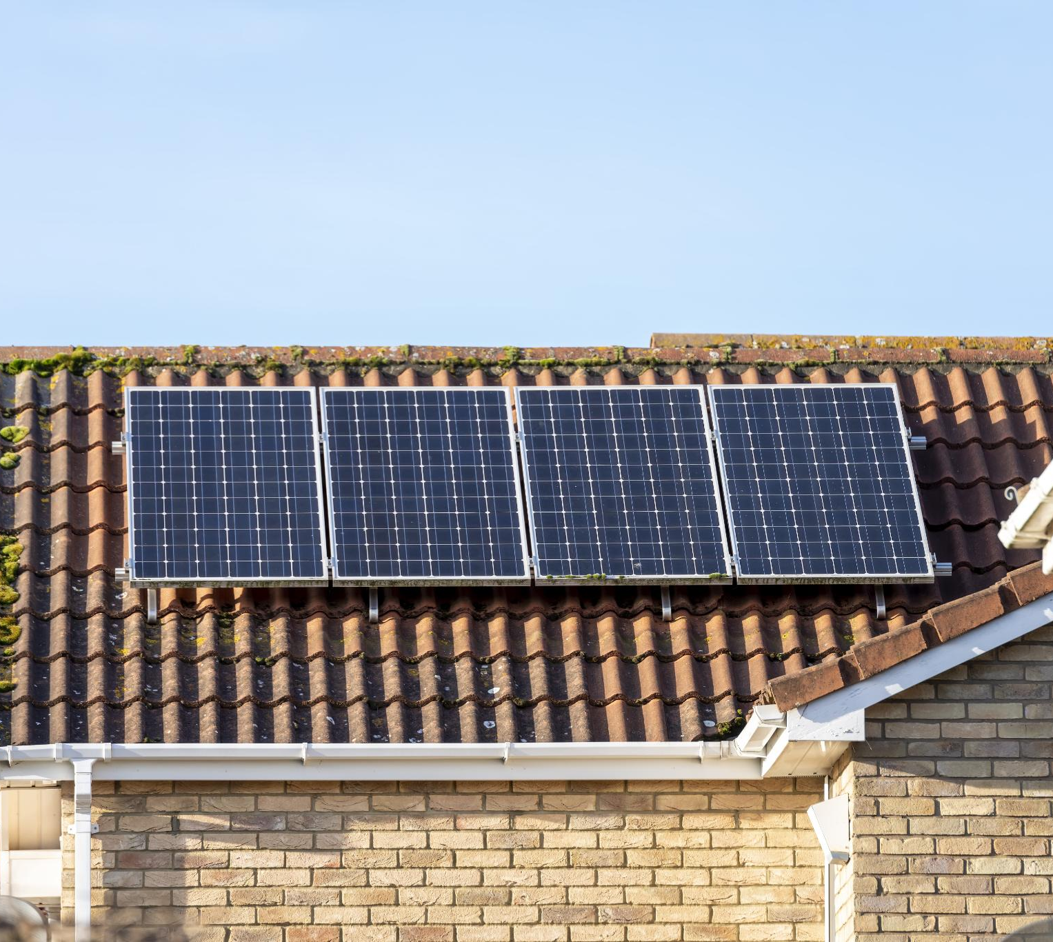
Introduction
Efficiency Metrics
Details on energy conversion rates
Installation Guidelines
Step-by-step installation process
Maintenance Tips
Regular cleaning and inspection advice
Environmental Benefits
Reduction in carbon footprint
Potential Cost Savings
Long-term financial benefits
Comparison of Solar Panels
Monocrystalline vs. Polycrystalline
Notes:
This slide covers the specifications for a medium residential roof-mounted solar panel array, including efficiency, installation, maintenance, environmental benefits, cost savings, and a comparison of monocrystalline and polycrystalline panels. Original Content: This document provides a detailed specification for a medium residential roof-mounted solar panel array. It covers efficiency metrics, installation guidelines, maintenance tips, environmental benefits, and potential cost savings over time. Additionally, it offers a comparison between monocrystalline and polycrystalline solar panels to help homeowners make an informed decision.

Slide 4
Panel Types
Monocrystalline Solar Panels
Made from a single crystal structure
Known for high efficiency and sleek appearance
Efficiency rate: 15-20%
Polycrystalline Solar Panels
Composed of multiple silicon crystals
Generally less expensive
Efficiency rate: 13-16%
Notes:
Monocrystalline solar panels are made from a single crystal structure and have an efficiency rate of 15-20%. Polycrystalline panels are composed of multiple silicon crystals, are less expensive, and have an efficiency rate of 13-16%. Original Content: · Monocrystalline Solar Panels: Made from a single crystal structure, these panels are known for their high efficiency and sleek appearance. They typically have an efficiency rate of 15-20%. · Polycrystalline Solar Panels: Composed of multiple silicon crystals, these panels are generally less expensive but also slightly less efficient, with an efficiency rate of 13-16%.

Slide 5
Efficiency Metrics
Energy Conversion Efficiency
Monocrystalline panels: 15-20% efficiency
Polycrystalline panels: 13-16% efficiency
Temperature Coefficient
Monocrystalline panels: lower temperature coefficient
Better performance in high temperatures
Durability and Lifespan
Both types last 25-30 years
Monocrystalline panels often have longer warranty periods
Notes:
Monocrystalline panels offer higher efficiency (15-20%) compared to polycrystalline (13-16%). They also perform better in high temperatures and often come with longer warranties. Both types have a lifespan of 25-30 years. Original Content: · Energy Conversion Efficiency: This indicates the percentage of sunlight that can be converted into usable electricity. Monocrystalline panels typically offer higher efficiency rates (15-20%) compared to polycrystalline panels (13-16%). · Temperature Coefficient: This metric measures how well the panel performs in high temperatures. Monocrystalline panels generally have a lower temperature coefficient, making them more efficient in hot climates. · Durability and Lifespan: Both panel types are built to last, with a typical lifespan of 25-30 years. However, monocrystalline panels often come with a longer warranty period.

Slide 6
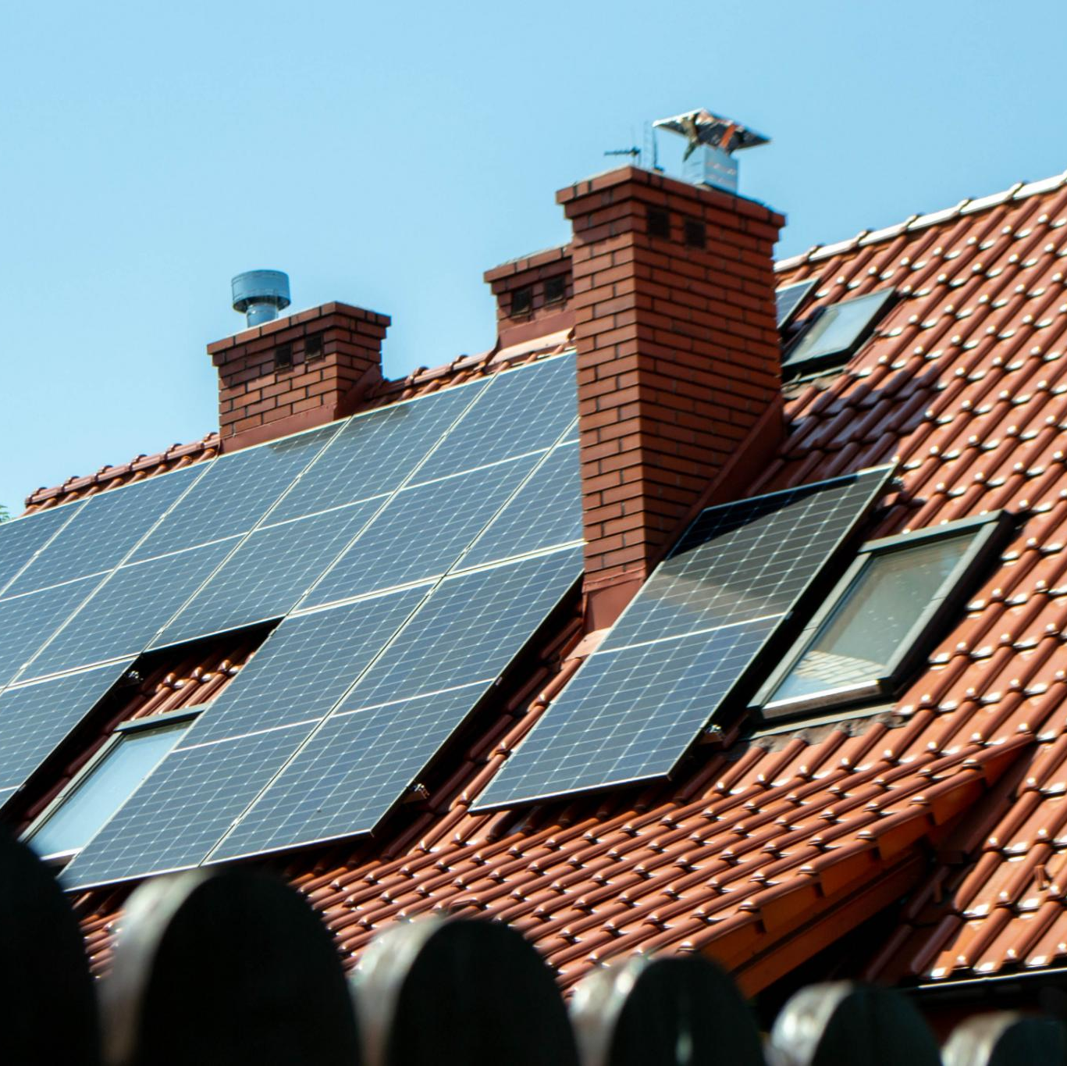
Site Assessment
Analyze Roof Structure
Ensure it can support the additional weight of solar panels
Evaluate Roof Orientation and Tilt
Maximize sunlight exposure
Identify Shading Issues
Check for shading from nearby trees or buildings
Notes:
When installing solar panels, analyze your roof structure to ensure it can support the weight. Evaluate the roof's orientation and tilt for maximum sunlight exposure, and identify any shading issues from nearby trees or buildings. Original Content: · Conduct a thorough analysis of your roof structure to ensure it can support the additional weight of the solar panels. · Evaluate the roof's orientation and tilt angle to maximize sunlight exposure. · Identify any potential shading issues from nearby trees or buildings.

Slide 7
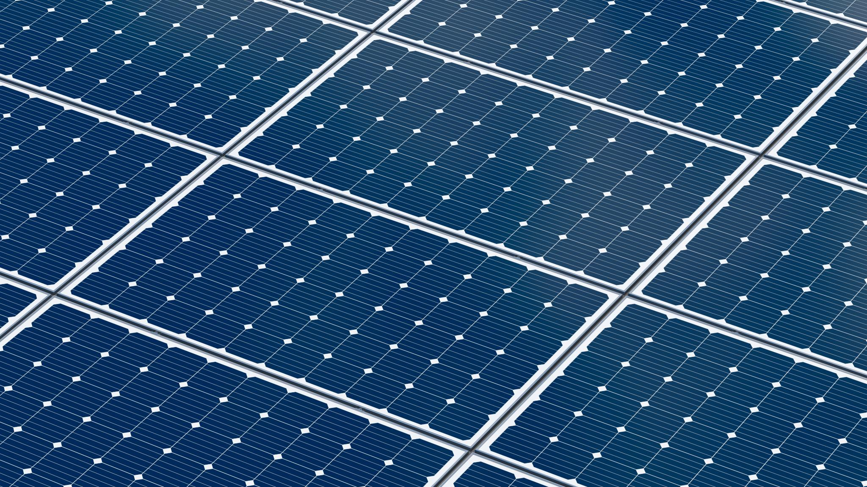
Mounting the Panels
Sturdy Mounting System
Withstands local weather conditions
Handles high winds and heavy snow loads
Optimal Tilt Angle
Typically between 30-45 degrees
Maximizes solar exposure
Proper Spacing Between Panels
Allows for thermal expansion
Ensures adequate ventilation
Notes:
For effective solar panel installation, use a sturdy mounting system, install panels at a 30-45 degree tilt angle, and ensure proper spacing for thermal expansion and ventilation. Original Content: · Use a sturdy mounting system that can withstand local weather conditions, including high winds and heavy snow loads. · Install the panels at an optimal tilt angle (typically between 30-45 degrees) to maximize solar exposure. · Ensure proper spacing between panels to allow for thermal expansion and adequate ventilation.

Slide 8
Electrical Connections
Hire a Certified Electrician
Ensure safety and compliance with local codes
Install an Inverter
Convert DC electricity to AC electricity for home use
Consider Battery Storage System
Store energy for use during non-sunny periods
Notes:
To install solar panels, hire a certified electrician for safety and compliance. Install an inverter to convert DC to AC electricity. Consider a battery storage system for energy use during non-sunny periods. Original Content: · Hire a certified electrician to handle the electrical connections to ensure safety and compliance with local codes. · Install an inverter to convert the DC electricity generated by the panels into AC electricity for home use. · Consider installing a battery storage system for energy storage and use during non-sunny periods.

Slide 9

Cleaning and Inspection
Regular Cleaning
Remove dirt, dust, and debris
Enhances efficiency
Inspection
Check for damage or wear
Especially after severe weather
Electrical Connections
Check periodically
Ensure correct functioning
Notes:
To maintain solar panels, regularly clean them to remove dirt and debris. Inspect for damage, especially after severe weather, and periodically check electrical connections to ensure they are functioning correctly. Original Content: · Regularly clean the panels to remove dirt, dust, and debris that can reduce efficiency. · Inspect the panels and mounting system for any signs of damage or wear, especially after severe weather events. · Check the electrical connections and inverter periodically to ensure they are functioning correctly.

Slide 10
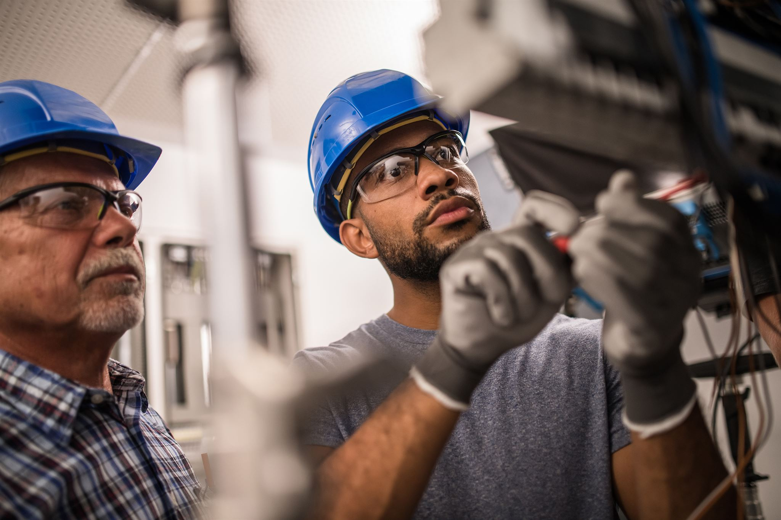
Professional Maintenance
Importance of Annual Inspections
Ensures optimal performance of equipment
Identifies potential issues early
Professional Maintenance
Performed by certified technicians
Includes thorough checks and necessary repairs
Scheduling Inspections
At least once a year
Can be scheduled more frequently if needed
Notes:
Schedule professional inspections and maintenance at least once a year to ensure optimal performance. This helps identify potential issues early and includes thorough checks and necessary repairs by certified technicians. Original Content: · Schedule professional inspections and maintenance at least once a year to ensure optimal performance.

Slide 11
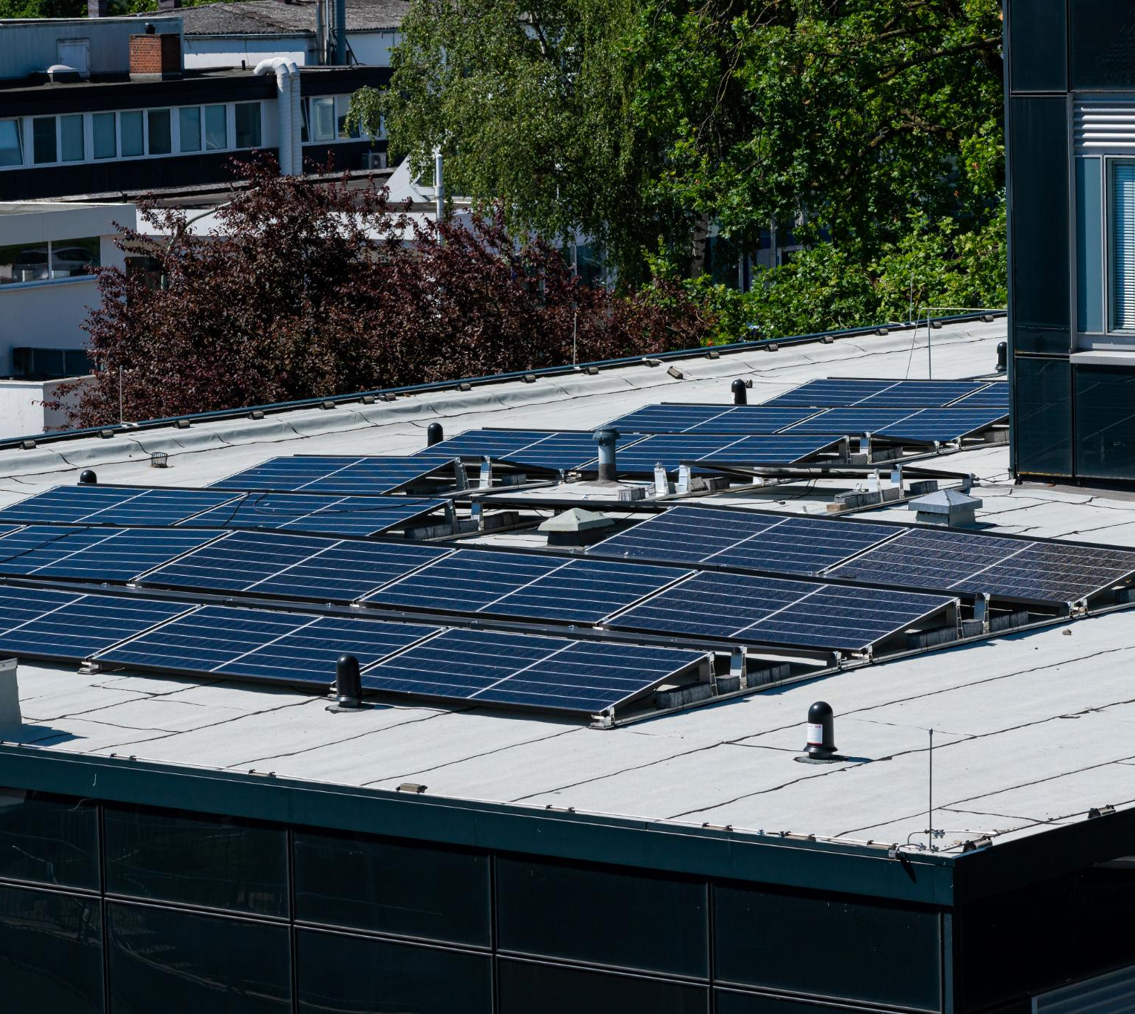
Environmental Benefits
Reduction in Carbon Footprint
Solar panels produce clean, renewable energy
Reduces reliance on fossil fuels
Lowers greenhouse gas emissions
Energy Independence
Generate your own electricity
Reduce dependence on the grid
Contribute to energy security
Sustainable Investment
Abundant solar energy resource
Does not deplete natural resources
Environmentally friendly
Notes:
Solar energy offers numerous benefits including reducing carbon footprint, promoting energy independence, and providing a sustainable investment. Solar panels generate clean energy, reduce reliance on fossil fuels, and lower greenhouse gas emissions. By generating your own electricity, you contribute to energy security and reduce grid dependence. Solar energy is abundant and environmentally friendly. Original Content: · Reduction in Carbon Footprint: Solar panels produce clean, renewable energy, reducing reliance on fossil fuels and lowering greenhouse gas emissions. · Energy Independence: By generating your own electricity, you reduce dependence on the grid and contribute to energy security. · Sustainable Investment: Solar energy is an abundant resource that can be harnessed without depleting natural resources or harming the environment.

Slide 12
Cost Savings Over Time
Initial Investment
Upfront cost can be significant
Incentives and tax credits available
Energy Bill Savings
Can reduce or eliminate monthly electricity bills
Leads to substantial savings over time
Return on Investment
Most homeowners see ROI within 5-10 years
Continued savings for the system's lifespan
Increased Home Value
Solar panels can increase market value
Makes home more attractive to buyers
Notes:
Installing solar panels offers several benefits. Although the initial investment can be high, incentives and tax credits help. They reduce energy bills, provide a return on investment within 5-10 years, and increase home value. Original Content: · Initial Investment: While the upfront cost of solar panels can be significant, various incentives and tax credits are available to reduce the financial burden. · Energy Bill Savings: Solar panels can significantly reduce or even eliminate your monthly electricity bills, leading to substantial savings over time. · Return on Investment: Most homeowners see a return on investment within 5-10 years, with continued savings for the lifespan of the system. · Increased Home Value: Installing solar panels can increase your home's market value, making it more attractive to potential buyers.

Slide 13
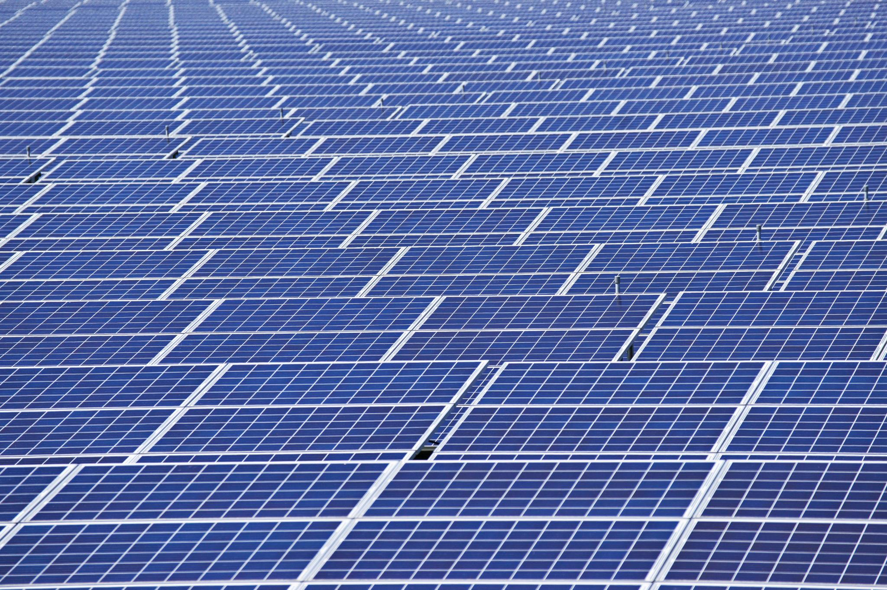
Base Prices
Monocrystalline Panels
Cost ranges from $0.80 to $1.50 per watt
Polycrystalline Panels
Cost ranges from $0.60 to $1.00 per watt
Notes:
Monocrystalline panels cost between $0.80 and $1.50 per watt, while polycrystalline panels range from $0.60 to $1.00 per watt. Original Content: · Monocrystalline Panels: $0.80 to $1.50 per watt · Polycrystalline Panels: $0.60 to $1.00 per watt

Slide 14
Average Pricing for a 3400 Square Foot Home
Monocrystalline Panels
Cost: $30,800 to $49,000
Assumption: 26 kW system
Polycrystalline Panels
Cost: $20,600 to $32,000
Assumption: 26 kW system
Notes:
This slide compares the costs of monocrystalline and polycrystalline solar panels, assuming a 26 kW system. Monocrystalline panels range from $30,800 to $49,000, while polycrystalline panels range from $20,600 to $32,000. Original Content: · Monocrystalline Panels: Approximately $30,800 to $49,000 (assuming 26 kW system) · Polycrystalline Panels: Approximately $20,600 to $32,000 (assuming 26 kW system)

Slide 15
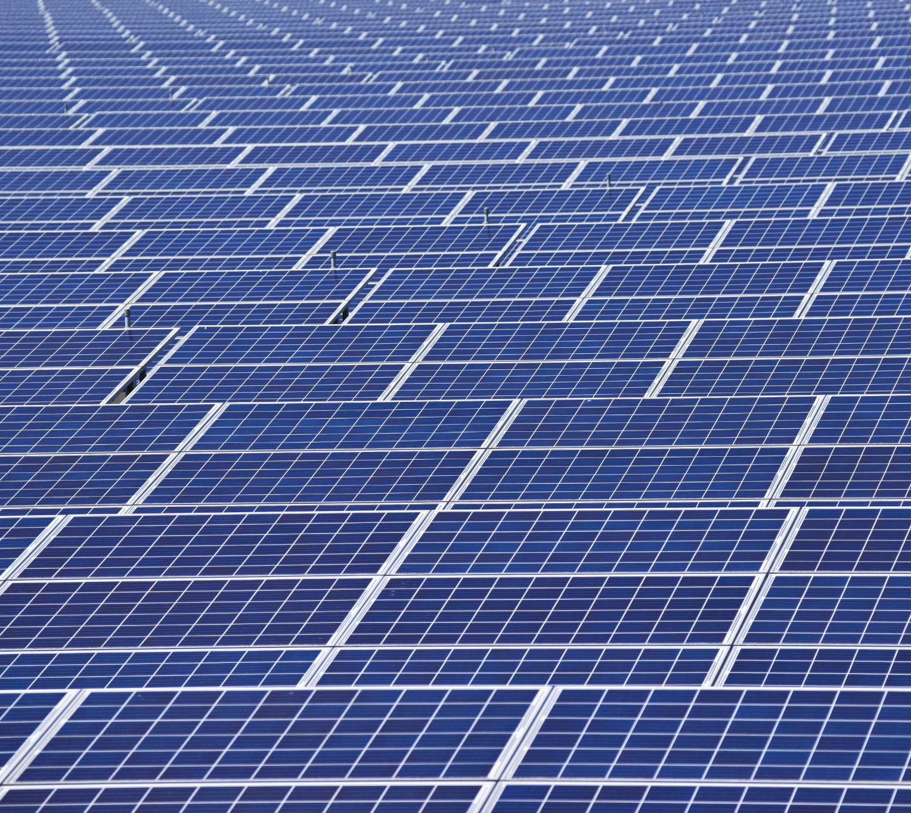
Discounts and Incentives
Bulk Purchase Discounts
Save up to 10% on orders exceeding 10 kW
Seasonal Promotions
Special discounts available during peak installation seasons
Federal and State Tax Credits
Up to 26% tax credit available through federal incentives
Additional state-specific rebates
Referral Programs
Earn discounts for referring new customers
Financing Options
Low-interest financing available through selected partners
Notes:
We offer various discounts and incentives for solar installations, including bulk purchase discounts, seasonal promotions, federal and state tax credits, referral programs, and low-interest financing options. Original Content: · Bulk Purchase Discounts: Save up to 10% on orders exceeding 10 kW · Seasonal Promotions: Special discounts available during peak installation seasons · Federal and State Tax Credits: Up to 26% tax credit available through federal incentives, with additional state-specific rebates · Referral Programs: Earn discounts for referring new customers · Financing Options: Low-interest financing available through selected partners

Slide 16
Comparison of Panel Types
Efficiency
Monocrystalline panels: 15-20%
Polycrystalline panels: 13-16%
Cost
Polycrystalline panels are generally less expensive
Due to simpler manufacturing process
Appearance
Monocrystalline: uniform black color
Polycrystalline: blueish hue with speckled appearance
Space Requirements
Monocrystalline panels require less space
Longevity
Notes:
Monocrystalline panels are more efficient and space-saving but costlier. Polycrystalline panels are cheaper and have a distinct appearance. Both have similar lifespans, but monocrystalline panels often come with longer warranties. Original Content: · Efficiency: Monocrystalline panels are more efficient (15-20%) compared to polycrystalline panels (13-16%). · Cost: Polycrystalline panels are generally less expensive due to their simpler manufacturing process. · Appearance: Monocrystalline panels have a uniform black color, while polycrystalline panels have a blueish hue with a speckled appearance. · Space Requirements: Due to their higher efficiency, monocrystalline panels require less space to generate the same amount of electricity as polycrystalline panels. · Longevity: Both types have similar lifespans, but monocrystalline panels often come with longer warranties.

Slide 17
Comparison of Panel Types
Feature | Monocrystalline Solar Panels | Polycrystalline Solar Panels
Material | Single crystal silicon | Multiple silicon crystals
Efficiency | 15-20% | 13-16%
Appearance | Sleek, uniform black | Bluer, speckled
Cost | Higher | Lower
Space Efficiency | More efficient, requires less space | Less efficient, requires more space
Longevity | Generally longer lifespan | Slightly shorter lifespan
Notes:
This slide compares monocrystalline and polycrystalline solar panels, highlighting differences in material, efficiency, cost, appearance, and space efficiency. Original Content: · Table comparing the key differences between monocrystalline and polycrystalline solar panels.

Slide 18
Solar Panel Installation
Step | Description | Component
1 | Site Assessment | Solar Engineer
2 | Design and Planning | Design Software
3 | Permitting | Permit Documents
4 | Mount Installation | Mounting Hardware
5 | Panel Installation | Solar Panels
6 | Electrical Wiring | Wiring & Conduits
7 | Connecting Inverter | Inverter
8 | Battery Setup (if applicable) | Battery Storage
9 | System Testing | Testing Tools
10 | Activation | Monitoring System
Steps for Installing Solar Panels
Assess the roof for suitability
Install mounting brackets
Secure solar panels to brackets
Electrical Connection Setup
Connect solar panels to inverter
Set up battery storage system
Ensure proper grounding and safety measures
Notes:
This slide covers the steps for installing a residential roof-mounted solar panel array, including assessing the roof, installing brackets, and securing panels. It also details the electrical connection setup, involving the inverter and battery storage system. Original Content: · The steps and components involved in installing a residential roof-mounted solar panel array. · Steps for electrical connection setup, including the inverter and battery storage system.

Slide 19
Conclusion
Environmental Benefits
Reduces carbon footprint
Promotes sustainable energy use
Energy Independence
Decreases reliance on grid power
Provides a reliable energy source
Cost Savings
Lowers energy bills
Potential for government incentives
Efficiency Metrics
Installation Guidelines
Maintenance Tips
Notes:
Investing in residential roof-mounted solar panels offers environmental benefits, energy independence, and cost savings. Understand efficiency metrics, follow installation guidelines, and maintain your panels for optimal performance. Original Content: Investing in a medium residential roof-mounted solar panel array is a smart choice for environmentally-conscious homeowners looking to reduce their carbon footprint, achieve energy independence, and save on energy costs. By understanding the efficiency metrics, installation guidelines, and maintenance tips outlined in this document, you can make an informed decision and maximize the benefits of your solar investment.

